Slide 1
Lane following mobile robot
Group no. 7

Slide 2
Department of Electronics Engineering Lane Following Mobile Robot
Team Members
Chinmay Bhoir (TU1F1819006)
Mahendra Gudla (TU1F1819009)
Suchita Boga (TU1S1920004)
Sandhya Yadav (TU1S1920008)
Project Guide: Project Coordinator:
Prof. Vijaykumar Chaudhari Prof. Renuka Chimankare

Slide 3
contents
Abstract
Introduction
Literature Review
Problem Definition
Methodology
Hardware & Software Requirements
Applications
Conclusion
References

Slide 4
abstract
Lane Following is one of the most important aspects of robotics. A Lane Following Mobile Robot is an autonomous robot which is able to follow a lane that is drawn on the surface consisting of a contrasting color. It is designed to move automatically and follow the lane. The robot uses Raspberry Pi Camera to identify the lane and thus assisting the robot to stay on the track. The robot is driven by DC gear motors to control the movement of the wheels. The Arduino Uno interface is used to perform and implement algorithms to control the speed of the motors and to control steering of the robot to travel along the lane. This project aims to implement the algorithm and control the movement of the robot by proper control parameters and thus achieving better performance. We will be applying a learned perspective transformation in addition to the fixed “birds-eye view” transformation. This ensures robust lane fitting even if the road plane changes. It can be used industrial automated equipment carriers, small household applications, tour guides in museums.

Slide 5
introduction
The Project Lane Following Mobile Robot uses Camera sensors and modules to determine the lane and follow the path. Lane following robot is a machine that can follow a path. The path can be visible like a white line and black surface. Camera- based lane detection is what used to detect the lanes and position the robot in between the lanes properly and prevent the lane departure.

Slide 6
Literature review
No. of papers | Title | Authors | Year publish | Benefits | Limitations
Paper 1 | A Lane Following Mobile Robot Navigation System Using Mono Camera | Yeongcheol Cho | 2017 | It has reduced computation complexity. Gaussian filter is applied for removing the noise in image data. | Cost increases because there is the use of 2 sensors.
Paper 2 | Real-Time Road Lane Detection in Urban Areas Using LiDAR Data | Jiyoung Jung ID and Sung-Ho Bae | 2018 | Using 3D Lidar point cloud, we categorized the points of the drivable region and distinguished the points of the road signs on the ground. | Roads with drastic slopes and severe curvatures in mountainous areas could be challenging.
Paper 3 | Lane Detection Algorithm Using LRF for Autonomous Navigation of Mobile Robot | Jong-Ho Han and Hyun-Woo Kim | 2021 | Ensures safe driving under unfavorable road conditions such as fog. | It is difficult to detect the road lines beneath the parked cars on the side.

Slide 7
PROBLEM DEFINITION
In the industries, carriers are required to carry products from one point to another point which are usually in separate buildings or blocks. Conventionally, carts or trucks were used with human drivers. Unreliability and inefficiency in this part of the assembly line formed the weakest link. Our task is to build an autonomous car that can basically control or change the course of direction without any human input and using this system, we can properly reduce manpower and time delay.

Slide 8
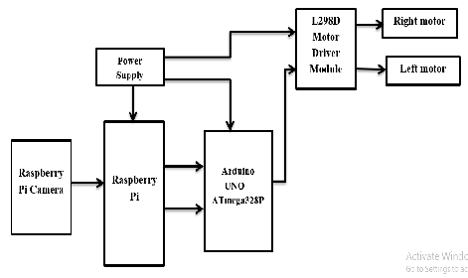
Methodology System design

Slide 9
Lane detection
Raspberry Pi camera will capture the image. Every image in OpenCV library by default it is in RGB colour spaces, then the image is converted in RGB colour spaces. With this RGB format, region of interest is processed.
Using region of interest, a perspective view is determined. The frame is then converted to grayscale image for detecting the edges and processing the two lines in the lane. Finally using the center of width of frame, the car follows with respective to the center and lines of frame.

Slide 10
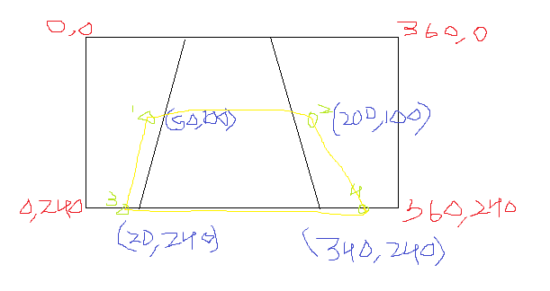
Region of interest

Slide 11
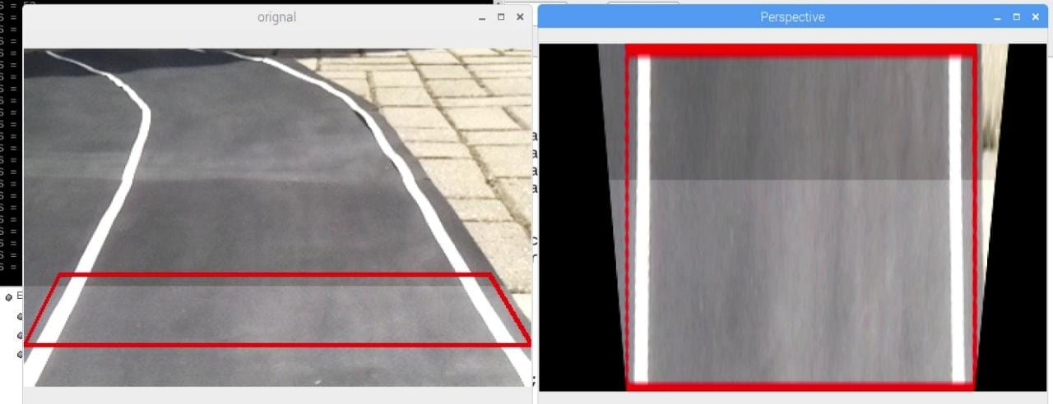
Perspective view

Slide 12
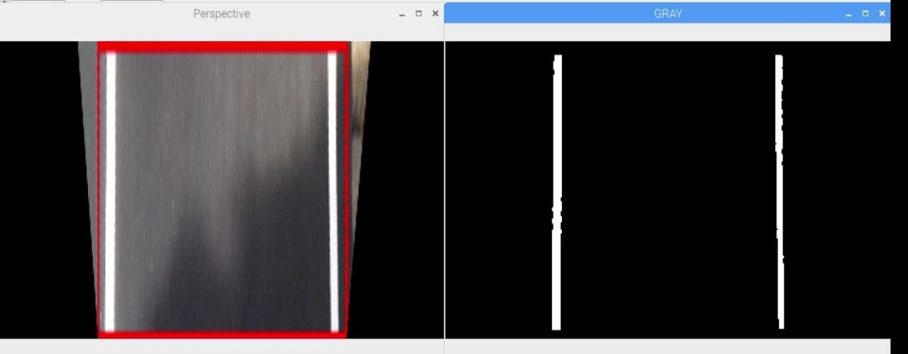
Grayscale image

Slide 13
Components requirements
HARDWARES REQUIREMENTS:
Raspberry Pi
Arduino UNO
DC Motor driver
DC Motor
SOFTWARE REQUIREMENTS:
C++

Slide 14
applications
Industrial automated equipment carriers.
Entertainment and small household applications.
Tour guides in museums and other similar applications.

Slide 15
conclusion
This proposed project is a very cost-efficient autonomous robot where we used Perspective Transformation and Canny Edge Detection Algorithms to detect lane. The position information was fed from the Raspberry Pi to Arduino, which controlled the motors speed and turns.

Slide 16
references
A Lane Following Mobile Robot Navigation System Using Mono Camera
Author: Yeongcheol Cho
Published: 2017
Real-Time Road Lane Detection in Urban Areas Using LiDAR Data
Author: Jiyoung Jung ID and Sung-Ho Bae
Published: 2018
Lane Detection Algorithm Using LRF for Autonomous Navigation of Mobile Robot
Author: Jong-Ho Han and Hyun-Woo Kim
Published: 2021

